Slide 1


Titolo presentazione sottotitolo
Polimi RecSys challenge 2023/2024
Milano, XX mese 20XX
Federico Ciliberto - 10938539
Francesco Zanella - 10835648

Slide 2
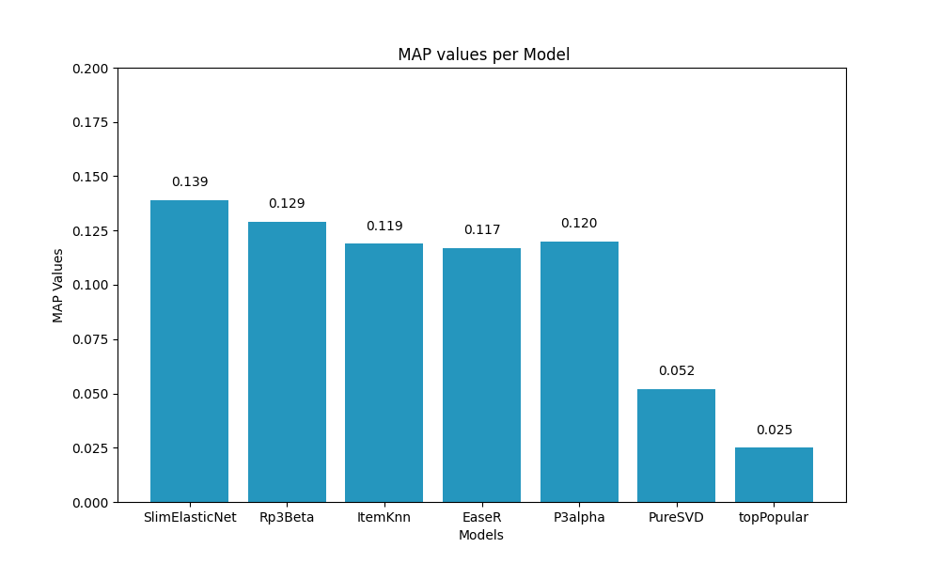
Roadmap – step 1
Standalone models optimization:
ItemKnn (MAP 0.119)
SlimElasticNet (MAP 0.139)
topPopular (MAP 0.025)
PureSVD (MAP 0.052)
Rp3Beta (MAP 0.129)
EaseR (MAP 0.117)
P3alpha (MAP 0.12)

Slide 3
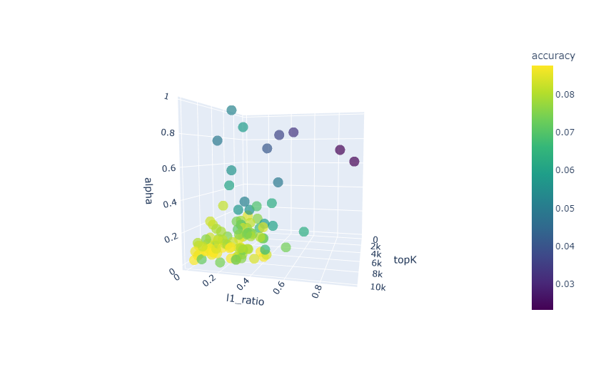
Optimization approach
Scatter plot of the results to find the most promising hyperparameters region (for models with 3 hyperparameters only!)

Slide 4
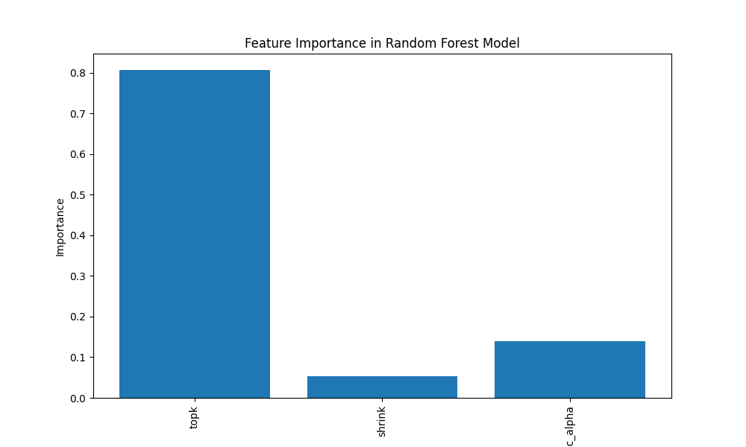
Optimization approach
Identification of the most relevant features for hyperparameters tuning.
Focus of optimization efforts on features identified as crucial to improving performance.

Slide 5
Roadmap – step 1 : what didn't work
Other attempts and trials that didn't work out:
Some data preprocessing techniques (log heuristics)
Outliers removal

Slide 6
Roadmap – step 2
2. Hybridization SLIM_en + RP3beta + ItemKNN
Various approaches were tried to find the best weights (grid search, optuna).
The best combination was:
0.6 SLIM
0.2 RP3beta
0.2 ItemKNN
The MAP obtained was 0.1415.
Notes:
Abbiamo provato a realizzare ibridi con vari tipi di modelli

Slide 7
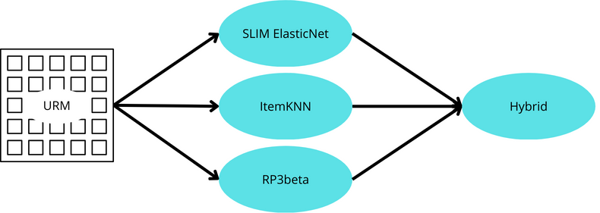
Roadmap – step 2
Hybrid scheme
Notes:
Abbiamo provato a realizzare ibridi con vari tipi di modelli

Slide 8
Roadmap – step 2: what didn't work
Other attempts and trials that didn't work out:
Hybridization summing ratings
Hybridization of multiple hybrids
User-wise hybrids

Slide 9
Roadmap – step 3
3. Boosting
We used XGB to further improve the performances of our model.
A representation of the architecture can be found in the next slide.

Slide 10
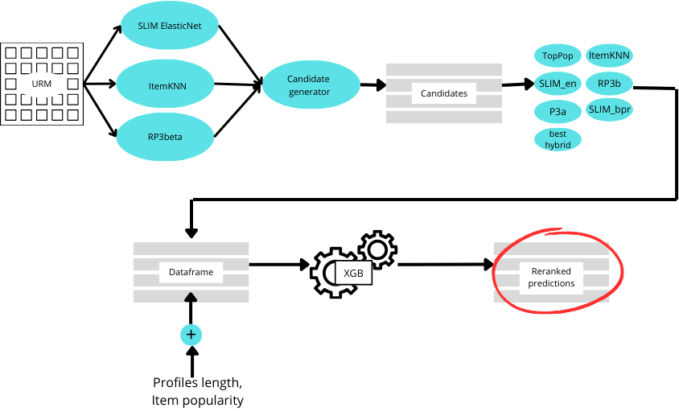
XGB architecture

Slide 11
Candidate generator
We have immediatly noticed how a better candidate generator, reflected in a much higher final MAP in XGBoost.
Thus, for the candidates generation, we tried to develop a specific model with optimized recall.
Approaches tried:
Single models
Similarity matrices hybridization
Voting systems
The best model was an hybrid of SLIMen, ItemKNN, RP3beta, all optimized for recall.

Slide 12
XGB features
We used as features:
Top Popular
RP3beta
SLIMen
SLIMbpr
ItemKNN
The best hybrid (SLIMen + ItemKNN + RP3b)
P3alpha
User profile length
Item popularity

Slide 13
Final results
The best XGB model achieved:
0.14324 on public leaderboard
0.14249 on private leaderboard

